Slide 1
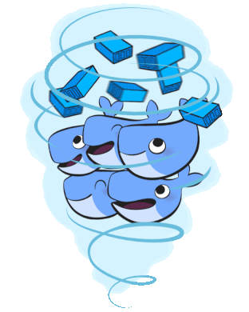
Docker
Introductie containerization
Notes:
Jullie iets vertellen over containerization
Voordelen van containers
Mogelijke toepassingen
Veel vertellen, discussies hebben, begrip kweken.
Hopelijk delen jullie aan het einde wat van mijn enthousiasme

Slide 2

DOCKER?

Slide 3
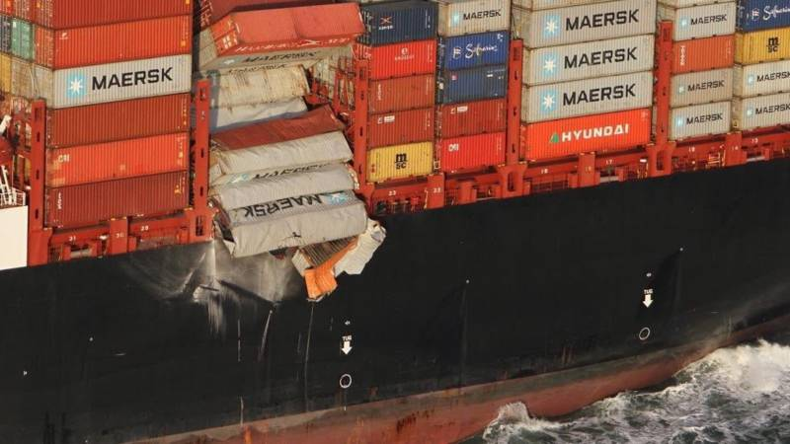
Containers, staan de laatste tijd wat negatief in het nieuws!

Slide 4
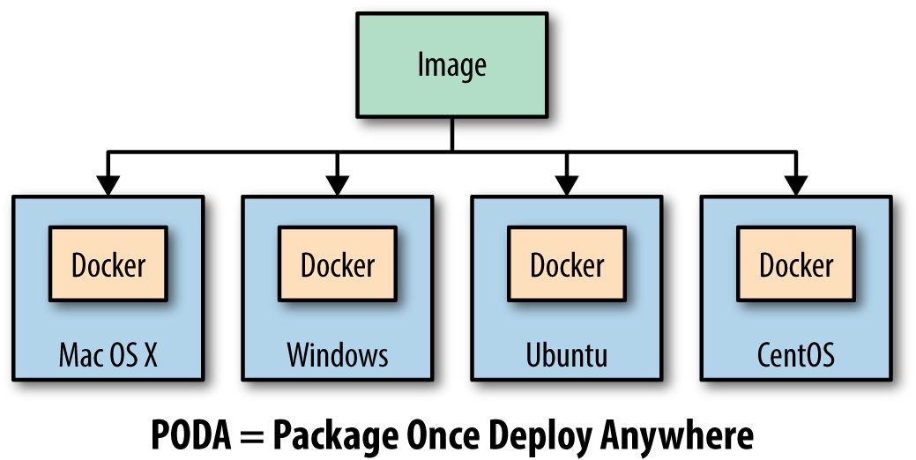
Docker : the game changer!
The developers can focus on building great applications and the ops guys can focus on building perfect service containers. The app guys can share app containers with ops guys and the ops guys can share MySQL and PosgreSQL and Redis servers with app guys.
That is why Docker is changing the face of development for our generation.
Notes:
PODA is not the same as WORA. A container created using Unix cannot run on Windows and vice versa as the base operating system specified in the Docker image relies on the underlying kernel. However, you can always run a Linux virtual machine (VM) on Windows or a Windows VM on Linux and run your containers that way.

Slide 5
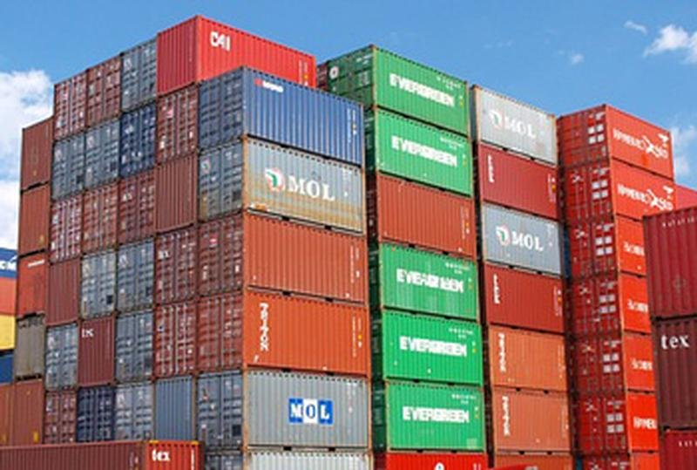
Docker is een open-source framework waarmee het mogelijk wordt een applicatie in een lichtgewicht, verplaatsbare container te verpakken en te executeren als waren het black boxes.
Notes:
Window containers is een ander vehaal

Slide 6
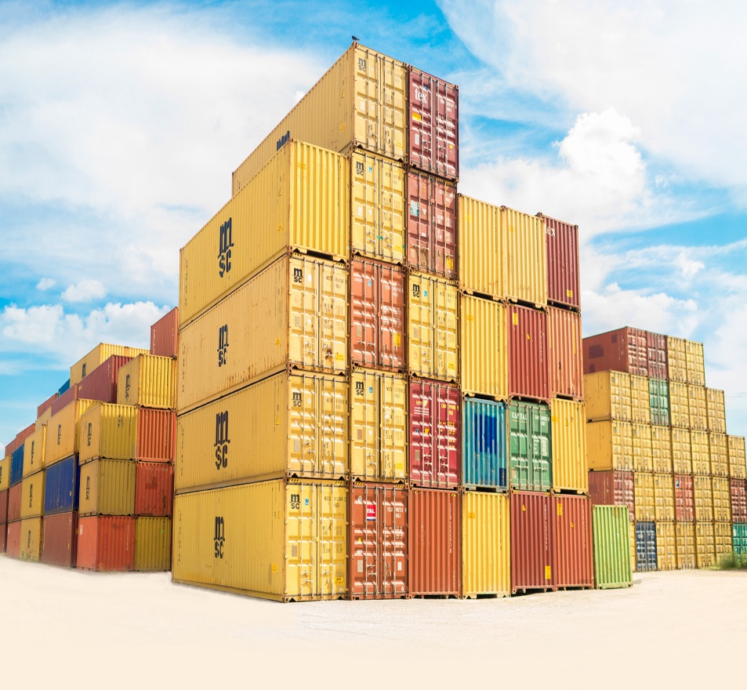
Alle containers worden uitgevoerd door één enkele kernel van het besturingssysteem en zijn dus lichter dan virtuele machines omdat deze ieder een volledig eigen OS hebben.
Elke container heeft de beschikking over eigen van elkaar gescheiden CPU, MEMORY, NETWORK en IO. Dit wordt mogelijkheid gemaakt door Linux cgroups en namespaces.
Een container is een soort ‘lichtgewicht VM’
Notes:
Windows containers is een apart verhaal. (Microsoft kruipt steeds dichter tegen Linux aan ☺)

Slide 7
docker stack
Runtime user space
Application (ear)
Application dependencies (libs/jre/tomcat)
OS Base Image (Linux or Windows)
Linux Kernel (any linux OS)
Contiainer
Docker engine
Linux Kernel or windows
Runtime
Notes:
OS Base Image: Keuze voor smaak Linux (of Windows). Hier zitten meer OS specieke libraries toegevoegd
DE onderste twee lagen boven de zwarten noemen we het image( (Soms zit ear er ook al bij, zeker in production containers). Wat niet meer is dan een zip bestand met filesystem opgebouwd uit laag over laag aan toevoegingen op de core image)

Slide 8
applIcaties in DE cloud
Wees zuinig met je VM resources zoals memory, CPU en storage. Onderzoek toont aan : “OS overhead per VM gem. 6-10%. Dus voor elke 1000 EURO verlies je 60 tot 100 EURO aan het OS alleen!”
Conflicterende applicatie dependencies limiteren het aantal applicaties dat je kan draaien in VM’s.

Slide 9
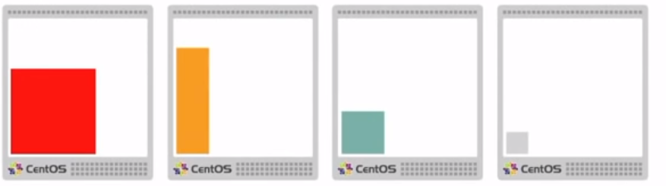
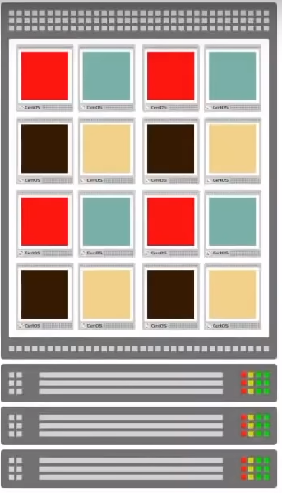
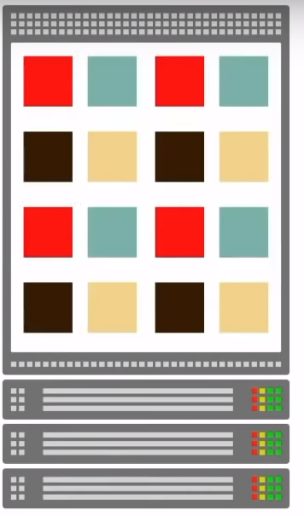
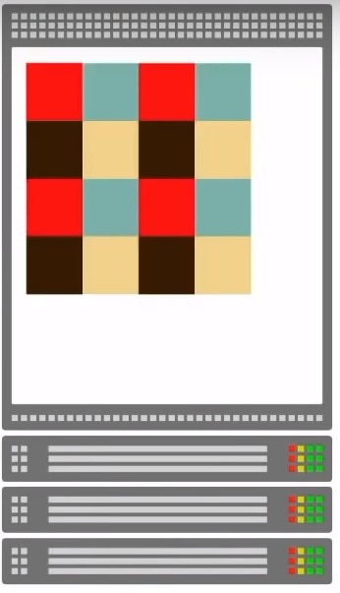
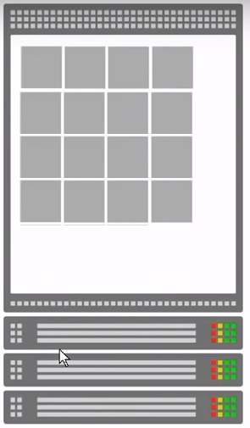
Containers could solve this
Notes:
Classieke VMs met sub optimaal gebruik van resources
Containers -> VM/OS deel valt weg
Weer compacter/efficienter
En ook nog eens black boxes. Geen conflicting dependencies meer

Slide 10
Ervaringen Met Docker
70 % consolidatie van VMs
66% totale kostenbesparingen IT infrastructuur
50% besparingen op IT • Platform standardisatie • Consistente applicatie leverstraat
50% reductie van vCPUs in QA – 25% in productie • Consistent platform/tooling • geen VM provisioning meer! • >50% developer boost

Slide 11
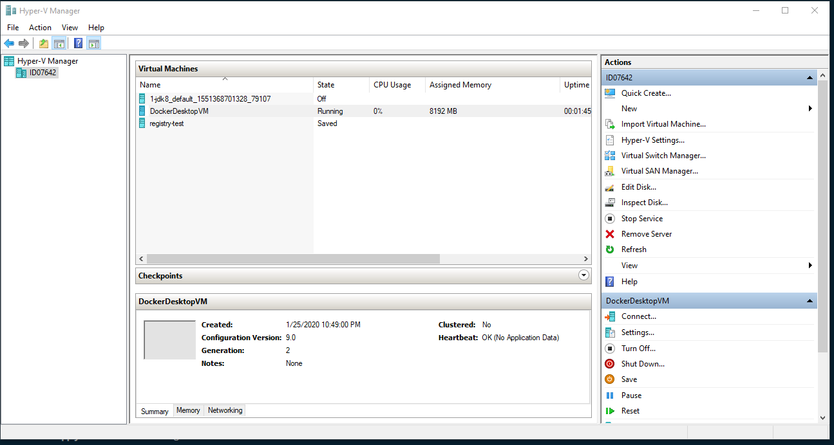
Installeren docker op windows
Zie : https://docs.docker.com/docker-for-windows/install/
Maak een dockerhub account aan op https://hub.docker.com/
BIOS-level hardware virtualization + Hyper-V enabled? (Hyper-V: mbv Turn Windows feature on or off)
Downloaden en runnen docker installer for Windows
Kunnen switchen tussen Hyper-V en andere (VMWare/Virtualbox) zie: https://www.hanselman.com/blog/SwitchEasilyBetweenVirtualBoxAndHyperVWithABCDEditBootEntryInWindows81.aspx

Slide 12
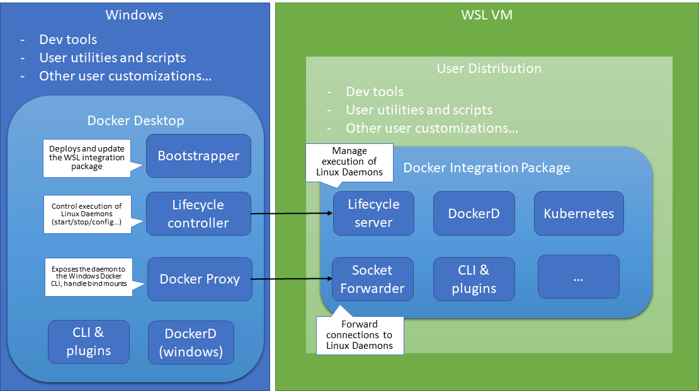
Alternatief: docker on Wsl2
Zie :https://www.thomasmaurer.ch/2019/08/run-linux-containers-with-docker-desktop-and-wsl-2/
Draait alleen op Windows 10 Insider Preview build 18932+.
Maak een dockerhub account aan op https://hub.docker.com/
Hyper-V onder water.

Slide 13
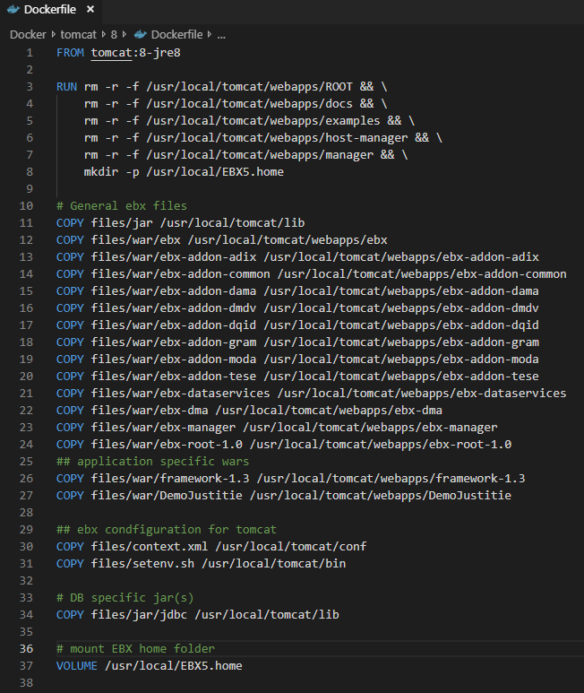
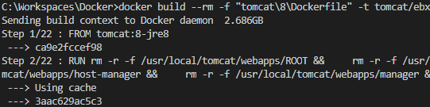
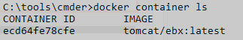
demo
Container basics: Demo & DockerHub
Notes:
Zie fun docker.
Laten zien met een pull
Daarna een run
Iets vertellen over docker hub.
http://www.habitus.io/

Slide 14
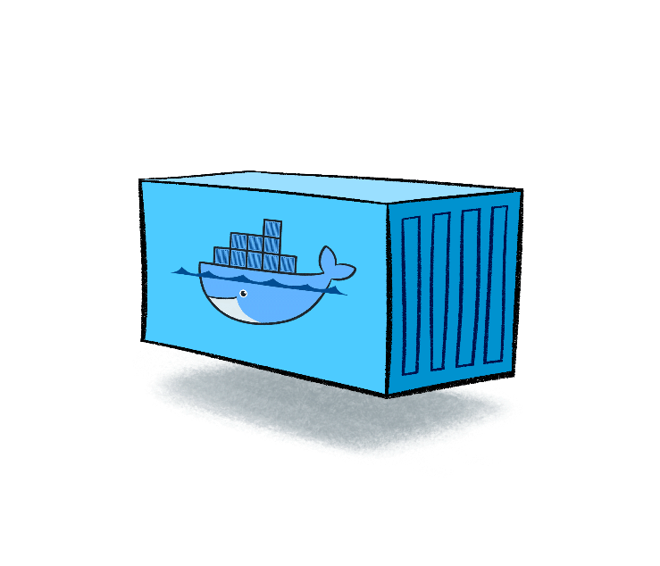
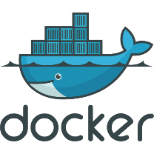
Bouwen eigen images?
Image
build
run
Dockerfile
Docker Image
Docker Container
Notes:
Dockerfile = Beschrijving van samenstelling van een container.
Image = Een tar/zip file met hierin een laag voor laag opgebouwd bestand.
docker run --rm -it ` -v /var/run/docker.sock:/var/run/docker.sock ` wagoodman/dive:latest <image> --source docker

Slide 15
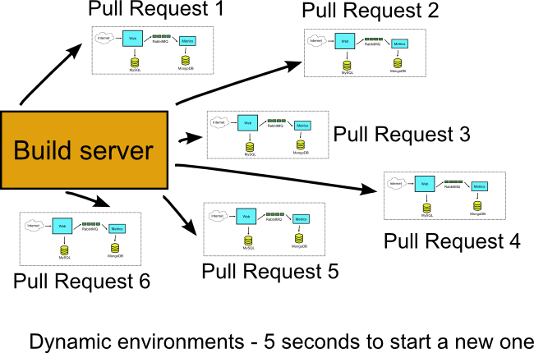
QUoteS PEOPLE IN THE FIELD
What we have realized after all the trial and error is that Docker containers are best suited for developers to run self-hosted applications quickly and easily. Developers can then test their code by connecting to these local instances instead of connecting to remotely hosted instances.
Docker gives you the ability to setup the complete environment locally and re-run the same integration tests the build server would perform after your commit. You can extend this idea to run any number of complete environments at the same time.
The important thing here is to abandon the practice of having multiple pre-defined VM environments (i.e. qa, staging, live) and instead have the build server create any number of deployment environments when needed.
Reproducibility
Environment Management
ISOLATION
Light weight VM
Notes:
Hybride omgevingen windows/linux in de maak

Slide 16
Docker ondersteuning development
Eclipse native
Docker tools
simple java container app
Maven
Fabric8io – maven plugin
Maven build containers
Multistage builds
JIB
Andere IDE’s ? (Intellij , visual studio code)
Notes:
1. Docker tools ok maar voegt niet zo veel toe, Java App in Container werkt niet. Wel simpel project maar wat voegt dit toe.

Slide 17
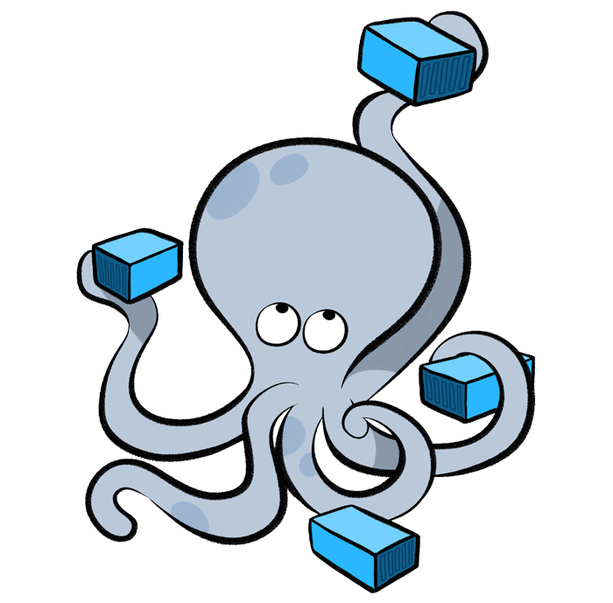
Het combineren van containers
DOCKER COMPOSE

Slide 18
docker & future (cloud) development
Develop inside a container
Eclipse CodeWind
Visual Studio Code Remote - Containers extension
container orchestrators:
Kubernetes (k8S)
Docker EE / Docker Swarm
Hybrid cloud, enterprise Kubernetes application platforms
Redhat Openshift
Rancher
Marathon
Eclipse che
Notes:
https://code.visualstudio.com/docs/remote/wsl
https://code.visualstudio.com/docs/remote/containers
https://github.com/carlossg/docker-maven
https://github.com/arun-gupta/docker-java-sample
https://github.com/javaee-samples/javaee7-docker-maven
https://github.com/GoogleContainerTools/jib.git
https://github.com/fabric8io/shootout-docker-maven
https://github.com/carlossg/docker-maven
https://github.com/susimsek/maven-jib-plugin
https://github.com/ravening/Spring-Boot-Kubernetes

Slide 19
MANAGED CONTAINER PLATFORM
Management
Networking & Storage
Container(s)
Container Runtime/Daemon
Cloud
Container OS
VM
Physical Host
Orchestration
Scheduling, Clustering, Discovery, provisioning, Monitoring, configuration management
Notes:
https://www.sumologic.com/devops/kubernetes-vs-mesos-vs-swarm/
https://blog.kubernauts.io/your-container-orchestration-needs-kubernetes-vs-mesos-vs-docker-swarm-1efa9acb69be
http://archive.work-bench.com/blog/2016/07/12/why-kubernetes-is-foundational-for-fortune-500-digital-transformation/
https://rancher.com/comparing-rancher-orchestration-engine-options/
https://www.loomsystems.com/blog/single-post/2017/06/19/kubernetes-vs-docker-swarm-vs-apache-mesos-container-orchestration-comparison
Demo docker swarm

Slide 20
Wrap up
Development: Setting up multiple isolated development environments Running and debugging on production like environments Use it without polluting your local environment
Testing: Setting up multiple isolated test environment Do production like testing locally
Deployment and Packaging: Easy construction of production hardened containers
Notes:
Testing: Test environments can be even more challenging because they will likely represent a larger number of run-time variations - for example, different frameworks and databases, different versions of Java, and so on. And this is only complicated by developing and running in virtualized environments.
Similar to the development example, the ability to spin up many Docker containers based on specific custom images make it much easier to have many representative test environments. To test your application in different versions of Java, you can simply run your application in multiple containers. You can set up containers for your databases as well. This will dramatically speed up your testing process.
Deployment and Packaging: Deployment with Docker is also simple and easy. For example, if your application runs in your local environment using a Docker container, then it will run on the target server as well.
By packaging your application in a container with all of its configurations and dependencies, you ensure that it will always work locally or on another machine, or in test and production environments. No more worries about having to install the same configurations into different environments.

Slide 21

I KNOW DOCKER!
Now I’m smart

Slide 22
Wrap up -
Docker is en wordt steeds meer een van de fundamenten van DevOps.
Iedere software engineer moet kennis van hebben van containarization en Docker
Je telt anders niet meer mee!
Makkelijke instap:
https://training.play-with-docker.com/
Notes:
Testing: Test environments can be even more challenging because they will likely represent a larger number of run-time variations - for example, different frameworks and databases, different versions of Java, and so on. And this is only complicated by developing and running in virtualized environments.
Similar to the development example, the ability to spin up many Docker containers based on specific custom images make it much easier to have many representative test environments. To test your application in different versions of Java, you can simply run your application in multiple containers. You can set up containers for your databases as well. This will dramatically speed up your testing process.
Deployment and Packaging: Deployment with Docker is also simple and easy. For example, if your application runs in your local environment using a Docker container, then it will run on the target server as well.
By packaging your application in a container with all of its configurations and dependencies, you ensure that it will always work locally or on another machine, or in test and production environments. No more worries about having to install the same configurations into different environments.

Slide 23
Uitdagingen java & docker?
Java (fix in java 8 betere ondersteuning van 9/10) startup normally queries the operating system in order to setup runtime defaults for things such as the number of GC threads and default memory limits. When running in a container, the operating system functions used provide information about the host and do not include the container configuration and limits.
Node.js wordt steeds populairder maar Java still strong (zeker met Spring Boot & Cloud)
Java grote memory footprint , lange startup time lang wn grote images. Mogelijke uitdagingen te gebruiken als microservices.
Toch wordt Java vervangen door andere techologieen: The main criteria for their selection to find a replacement for Spring Boot were developer efficiency, lower cloud resource consumption and shorter applications boot-up times. They considered the latter to be of great impact on cloud resource consumption costs as well as user experience improvement.
Therefore, where the application does not provide calculations or blocking processing, and is concerned with the development of a classic, small web application, I would almost certainly opt for development with the JavaScript stack described, while in other cases I would base the application on the Spring Boot stack that, in the long run, in my opinion, offers greater maintainability.

Slide 24
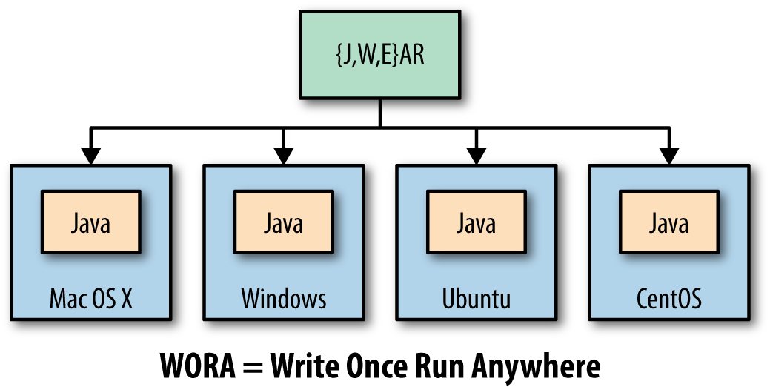

PODA? Wora toch?
Een Docker engine hebben we al in Java en dat heet een virtual machine.
In Java hoeven we niet te kiezen tussen windows of linux.
Ons build proces is al prima geregeld met maven en Jenkins.
Wat voegen containers nog toe?
Docker Term | Java World
Docker Image | WAR file
Docker Engine | JVM
Docker Container | Tomcat/Wildfly…
Docker Build | Maven
Dockerfile | Pom.xml
Docker Compose | EAR file
Docker Hub | Maven central
Docker Registry | Nexus
Notes:
Hybride omgevingen windows/linux in de maak
Dus waarom zouden we een JVM weer in een container stoppen?

Slide 25
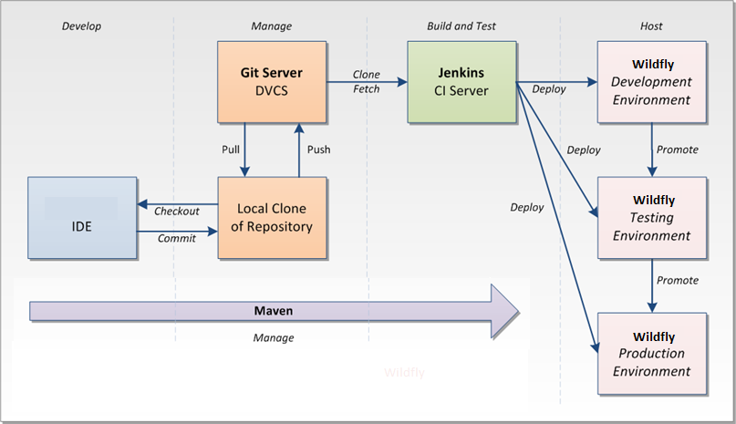
Standaard CI/CD

Slide 26
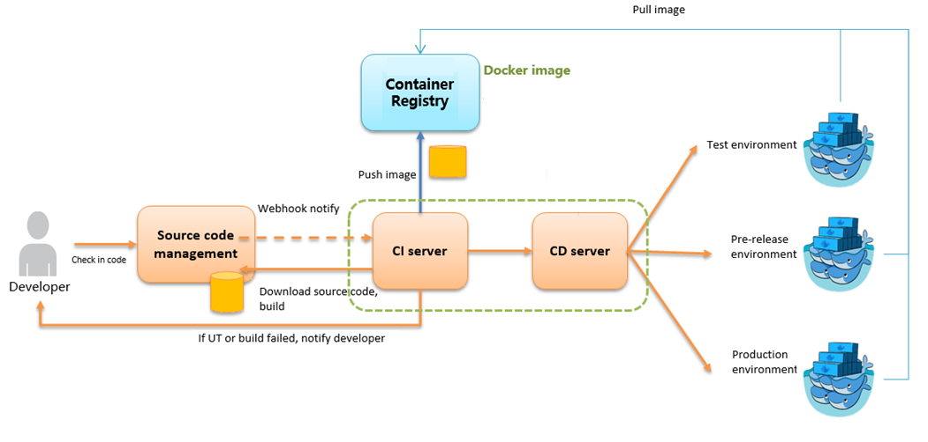
CI/CD met docker

Slide 27
MANAGED CONTAINER PLATFORM
Management
Networking & Storage
Container(s)
Container Runtime/Daemon
Cloud
Container OS
VM
Physical Host
Orchestration
Scheduling, Clustering, Discovery, provisioning, Monitoring, configuration management
Notes:
https://www.sumologic.com/devops/kubernetes-vs-mesos-vs-swarm/
https://blog.kubernauts.io/your-container-orchestration-needs-kubernetes-vs-mesos-vs-docker-swarm-1efa9acb69be
http://archive.work-bench.com/blog/2016/07/12/why-kubernetes-is-foundational-for-fortune-500-digital-transformation/
https://rancher.com/comparing-rancher-orchestration-engine-options/
https://www.loomsystems.com/blog/single-post/2017/06/19/kubernetes-vs-docker-swarm-vs-apache-mesos-container-orchestration-comparison
Demo docker swarm

Slide 28
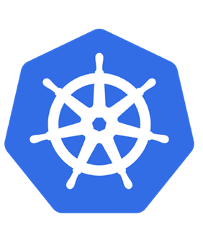
kubernetes
Management
Networking & Storage
Container(s)
Container Runtime/Daemon
Cloud
Container OS
VM
Physical Host
Orchestration
Notes:
https://www.sumologic.com/devops/kubernetes-vs-mesos-vs-swarm/
https://blog.kubernauts.io/your-container-orchestration-needs-kubernetes-vs-mesos-vs-docker-swarm-1efa9acb69be
http://archive.work-bench.com/blog/2016/07/12/why-kubernetes-is-foundational-for-fortune-500-digital-transformation/
https://rancher.com/comparing-rancher-orchestration-engine-options/
https://www.loomsystems.com/blog/single-post/2017/06/19/kubernetes-vs-docker-swarm-vs-apache-mesos-container-orchestration-comparison
Demo docker swarm

Slide 29
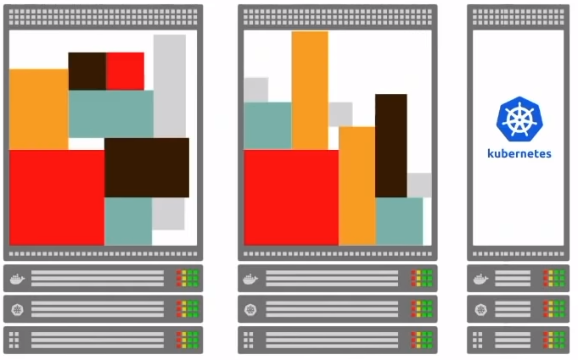
Kubernetes: container orchestrator

Slide 30
Toepassingen
LOKAAL / OP DE DESKTOP
Onze producten
BEST MATCH
Voor ontwikkelaars → Ontwikkel- /test omgeving lokaal zoals in productie. Voor beheer → namaken omgeving klant. Tijdelijke databases/ omgevingen. Voor Pre-sales → Demo’s in containers.
Lisa/DevTest → Niet veel voordeel. Is al gedistribueerd van nature, images zijn erg groot. Misschien draaien in de cloud. Geprobeerd maar niet erg succesvol.
EBX5 → Kan (nog) niet geheel via Docker want applicatie niet volledig geautomatiseerd te deployen.
Micro services. GitHub repositories
CI / CD
Notes:
MATCH MADE IN HEAVEN
Containers en microservices!
CI/CD straten (ING/ABNAMRO)

Slide 31
IT IS NOT A VM!
Container
Virtual machine
Application
Runtime
Base OS Image
Application
Guest OS
Runtime
=
Notes:
Containerization is the encapsulation of an application so that it can be deployed in a repeatable manner across an container-enabled platform and can be managed efficiently at scale.
Wat is hetvoordeel: Alleen maar containers verplaatsen/deployen….

